Slide 1
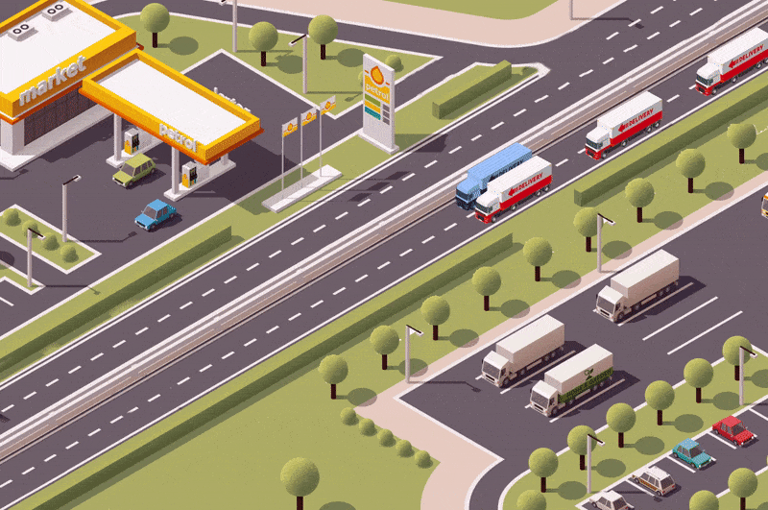
Truck Platooning Autonomous Systems A Lab
(Group B)
Jasmeet Singh Matta
Moshiour Rahman Prince
Shihab Ud Doula
Notes:
Jasmeet

Slide 2
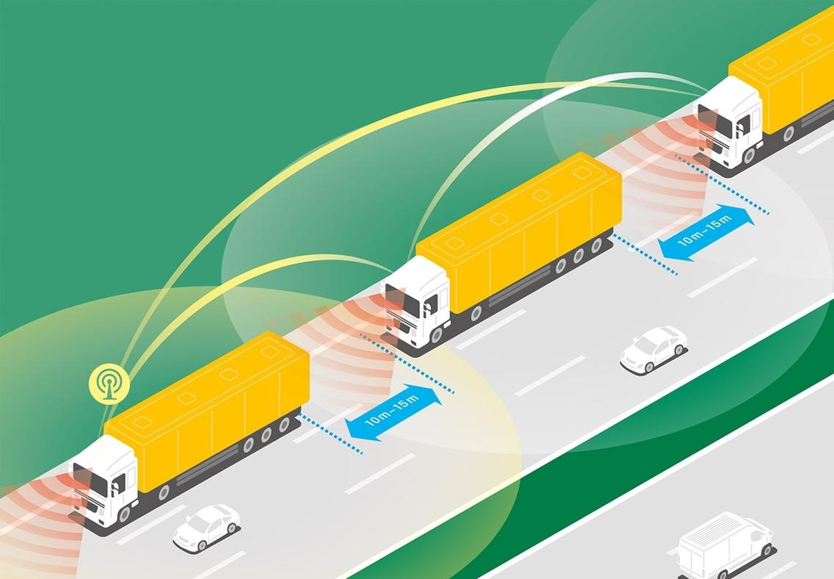
Introduction
Truck platooning: This technique involves multiple trucks driving in close formation, coordinated through communication systems.
Project Goal: Model, simulate and validate truck platooning scenarios
Figure 1: Truck Platooning Concept
Notes:
Jasmeet

Slide 3
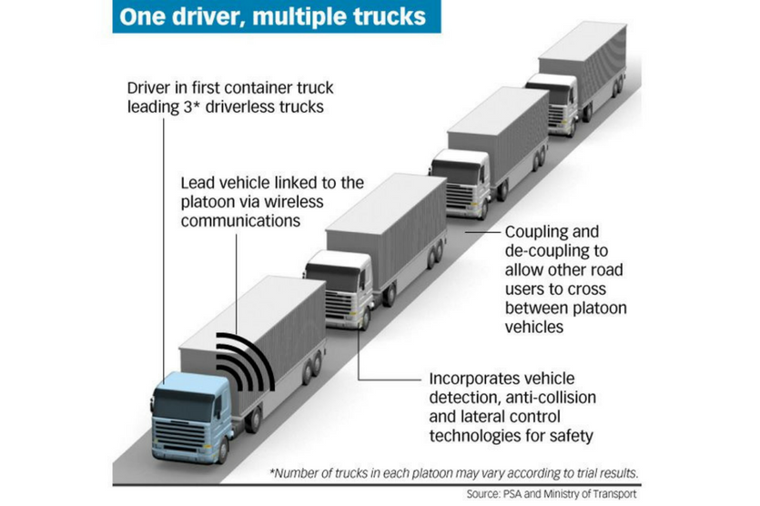
Motivation & Objective
Motivation:
Safety: Reduces accidents.
Efficiency: Lowers fuel consumption.
Traffic Flow: Optimizes road usage.
Objectives:
Model critical driving scenarios.
Ensure system robustness and stability.
Integrate advanced modelling and real-time data processing.
Figure 2: How does truck platooning work?
Notes:
Shihab

Slide 4
Identifying Key Scenarios
Obstacle Avoidance: Detect and respond to obstacles.
1
Lane Changing and Steering: Manage lane changes and steering to prevent collisions.
2
Environmental Model: Simulate system behavior in various environmental conditions.
3
Notes:
Shihab

Slide 5
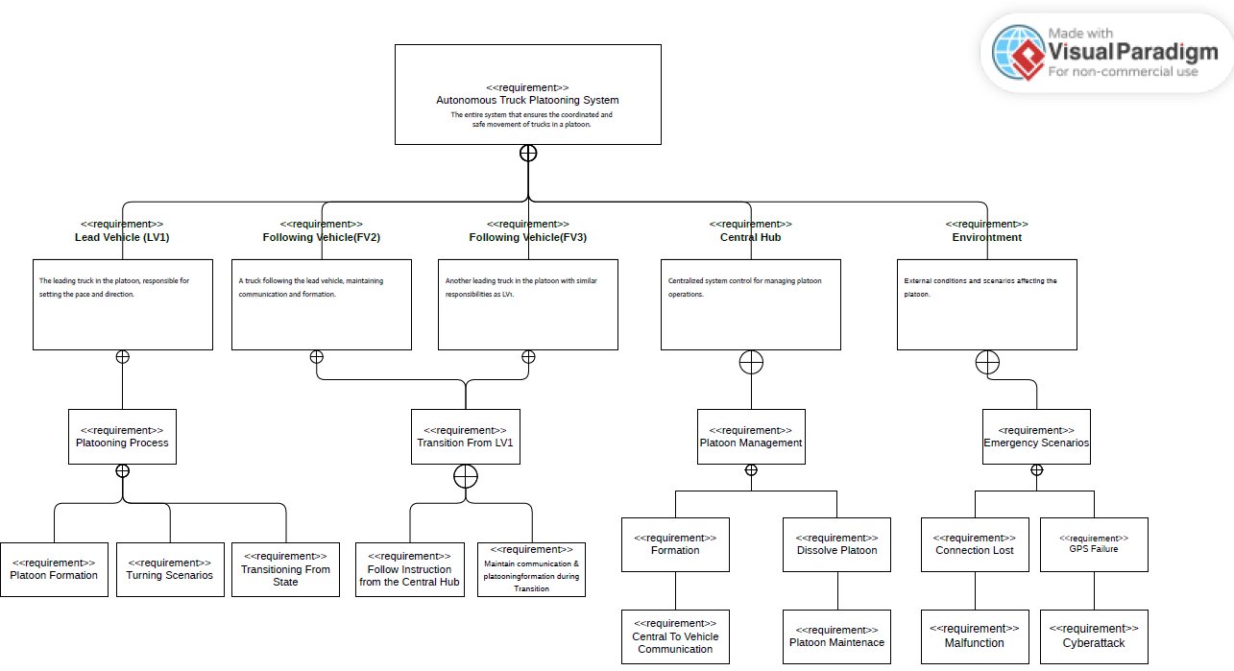
System Design with UML Diagrams
Requirement Diagram: Illustrates system components, including vehicles, central hub, and environment.
Notes:
Prince

Slide 6
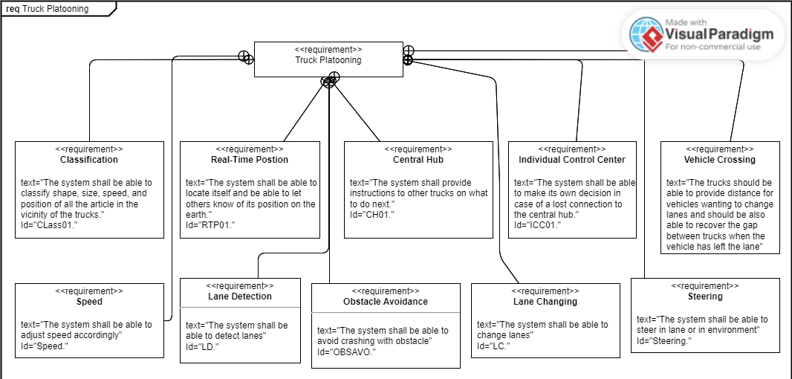
System Design with UML Diagrams
Requirement Diagram:
Illustrates system components
Including vehicles
Central hub & environment.

Slide 7
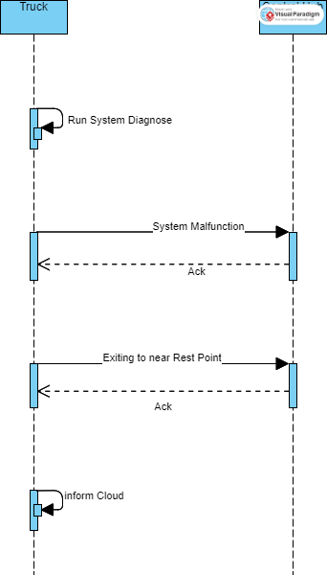
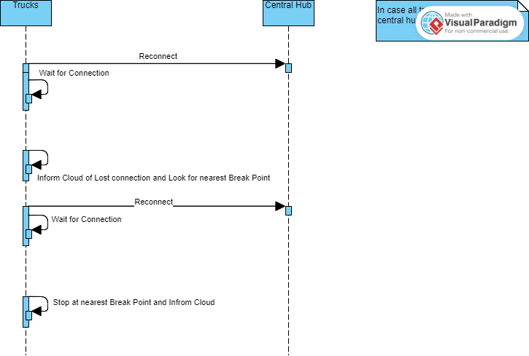
Sequence Diagram
Obstacle Avoidance: System diagnostics and handling of obstacles.
Figure 4: System Malfunction 2
Figure 3: System Malfunction 1

Slide 8
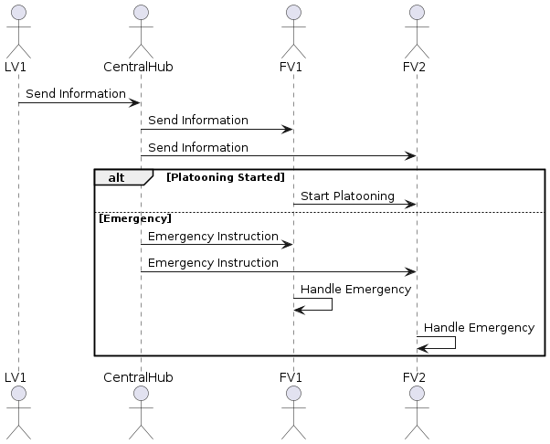
Environmental Model: Response to lost connections and emergencies.
Figure 5: Emergency Handleing
Notes:
Prince

Slide 9
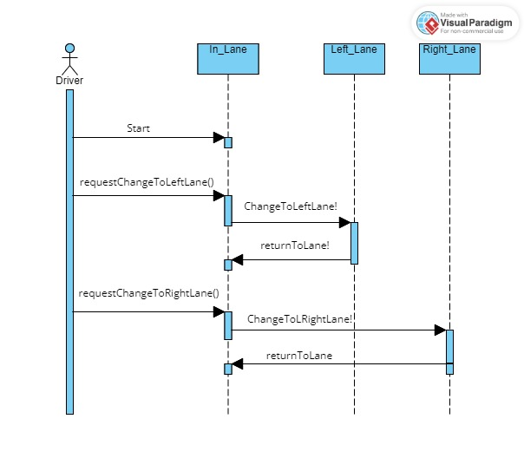
Lane Changing: Process for lane change requests and system responses.
Figure 5: Lane Changing & Steering
Notes:
Shihab

Slide 10
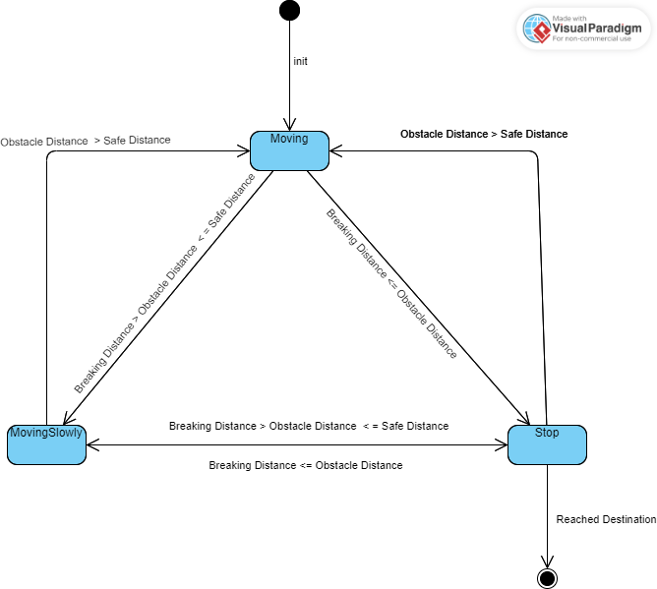
Obstacle Avoidance: State machine diagram for avoiding obstacle
Notes:
Jasmeet

Slide 11
Modeling Scenarios with UPPAAL
Obstacle Avoidance: Truck detects and responds to obstacles.
Lane Changing: Checks lane availability and executes lane changes safely.
System Integration: Combines all scenarios into one cohesive model, ensuring dynamic responses.
Notes:
Jasmeet

Slide 12
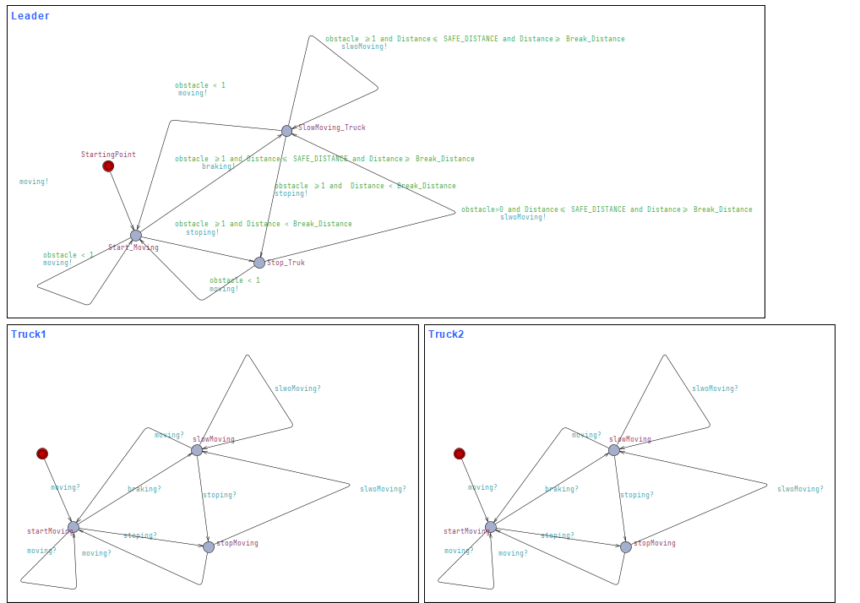
Obstacle Avoidance
Notes:
Jasmeet

Slide 13
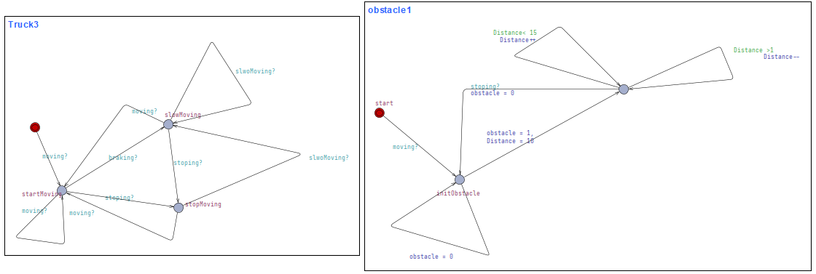
Obstacle Avoidance
Notes:
Jasmeet

Slide 14
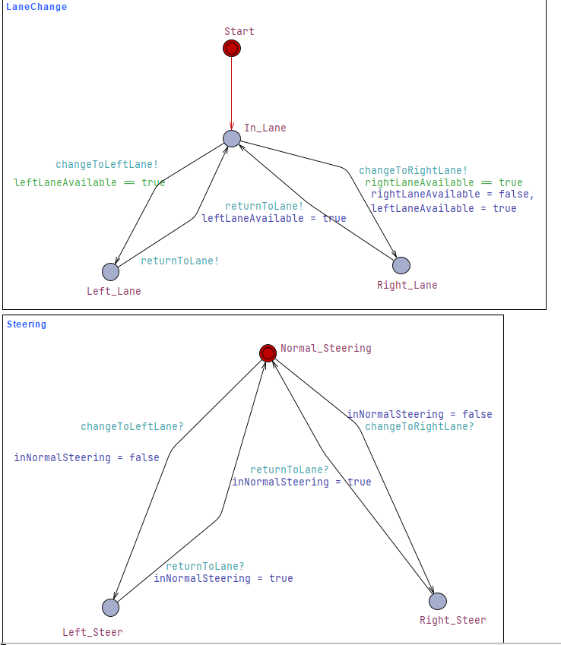
Lane Changing & Steering
Notes:
Shihab

Slide 15
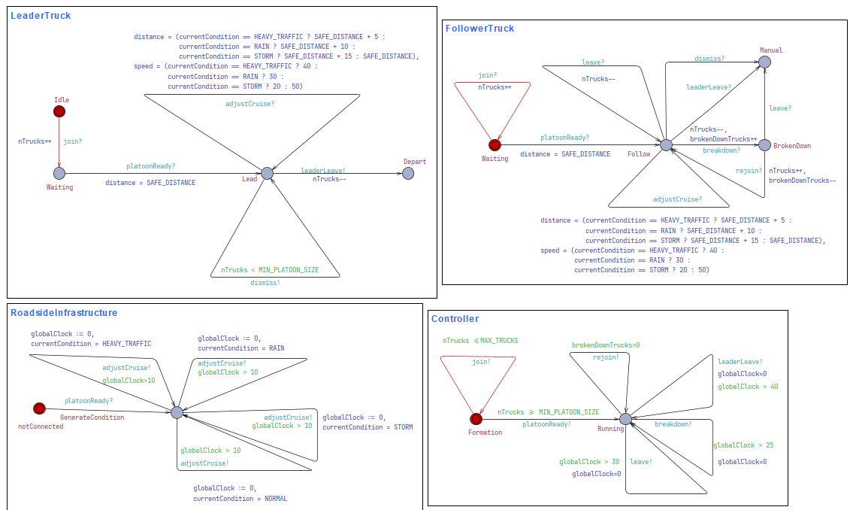
Environmental Model
Notes:
Prince

Slide 16
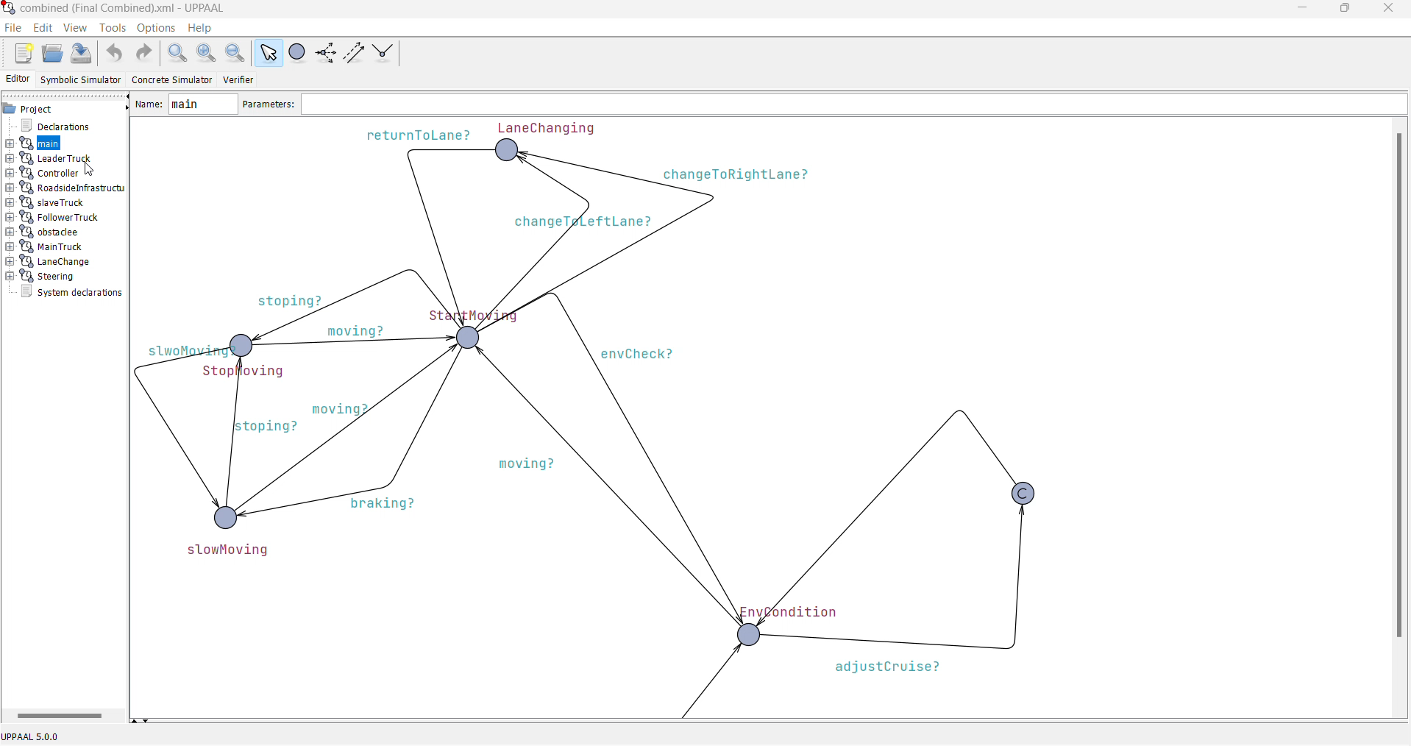
Combined Model

Slide 17

Decision Making with Machine Learning (Logistic Regression)
Leader Vehicle Determination
Implemented a logistic regression using Scikit-learn.
Key Parameters: Years of experience, Aerodynamic Score, Technological score
Training: Splitting a dataset into training and testing data, creating a logistic regression model, and then fitting that model to the training data.
Notes:
Prince

Slide 18
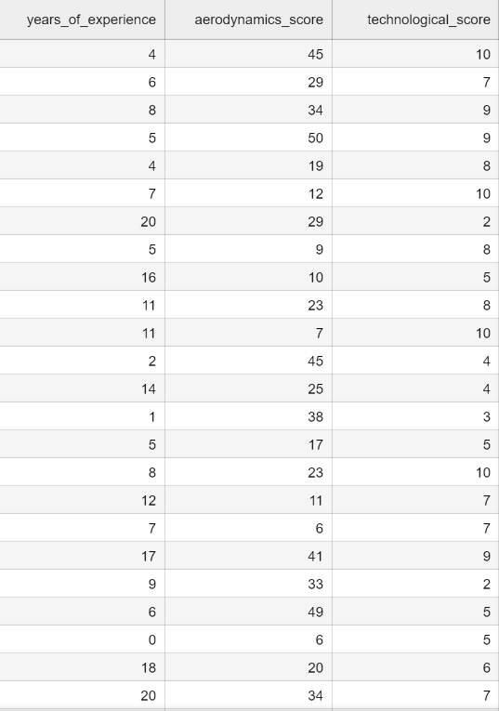

Machine Learning Implementation
Parameters
years_of_experience = (0, 20)
aerodynamics_score = (5, 50)
technological_score = (1, 10)
5000 samples
Notes:
Prince

Slide 19
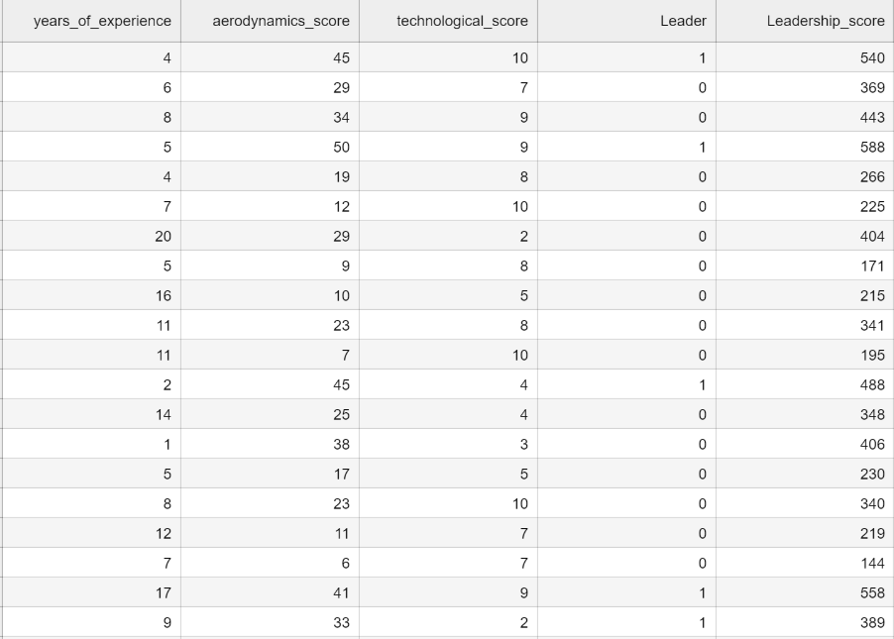
Data Preparation
Score = 𝑤1 ∙ 𝐴 + 𝑤2 ∙ 𝐵 + 𝑤3 ∙ 𝐶
𝑤1= 5; 𝑤2 = 10; 𝑤3 = 7;
A= years of experience
B = aerodynamics score
C = technological score
If score > 450 : leader = True
Notes:
Prince

Slide 20
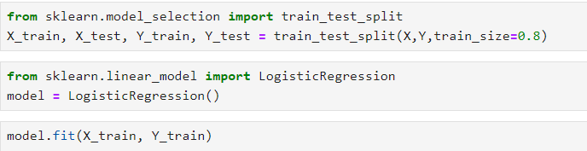
Model Training
Notes:
Prince

Slide 21
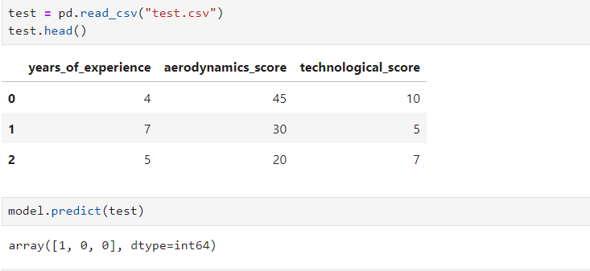
Leader Selection
Notes:
Prince

Slide 22
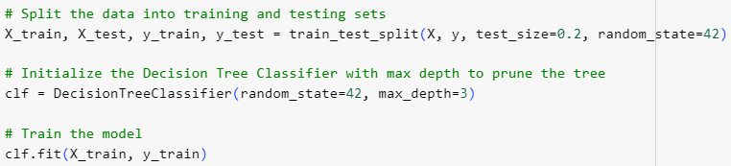
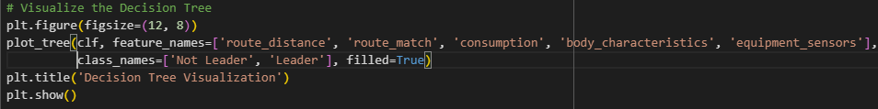
Notes:
Shihab

Slide 23
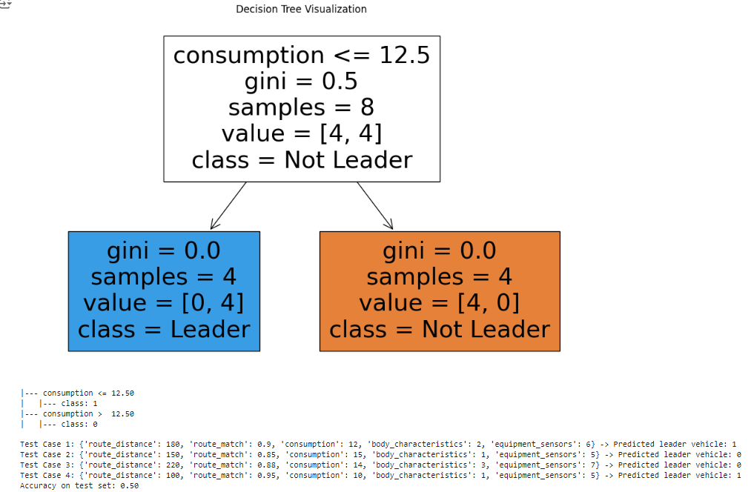
Leader Selection by Decision Tree
Notes:
Shihab

Slide 24
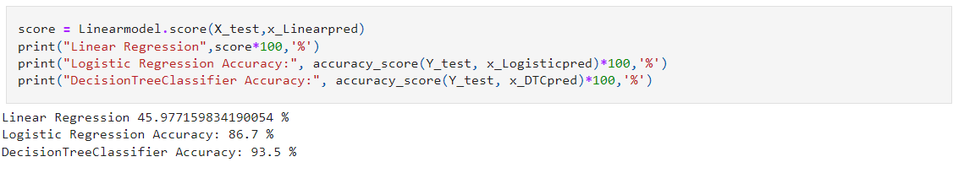
Analysing Solutions
Notes:
Jasmeet

Slide 25

Simulation Environment (Python) need update
Development: Built a simulation environment to test scenarios and the learning algorithm.
Integration: Ensured synchronization of scenarios and the learning algorithm.
Tools: Implemented in Python for real-time data processing.
Notes:
Shihab

Slide 26
Lane Changing
Notes:
Shihab

Slide 27
Environmental Changes
Notes:
Prince

Slide 28
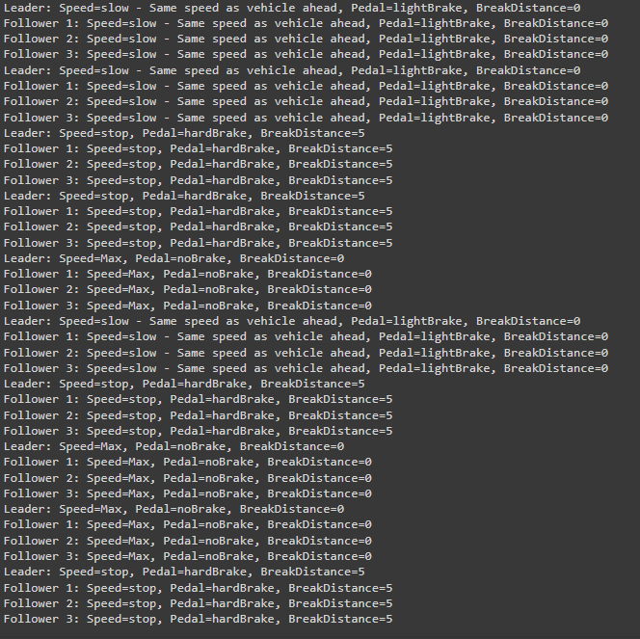
Obstacle Avoidance
Notes:
Jasmeet

Slide 29
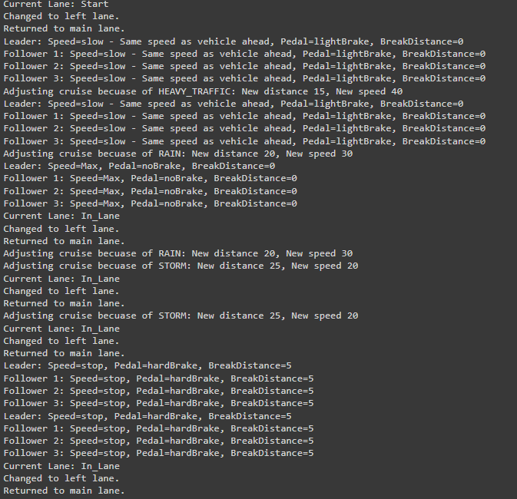
Overall Simulation
Notes:
Jasmeet

Slide 30
Video/code snippet

Slide 31

Conclusion and Future Work
Modeled and simulated key truck platooning scenarios
Demonstrated integration of UML, UPPAAL, and Python.
Future Work: Potential improvements include enhancing the learning algorithm and expanding the simulation environment.
Notes:
Prince

Slide 32
References
Milford, M. (2017, November 20). Coming soon to a highway near you—truck platooning. The Conversation. https://phys.org/news/2017-11-highway-youtruck-platooning.html
Truck platooning. (n.d.). Rapp AG. https://www.rapp.ch/de/stories/truck-platooning
Designing and Scheduling Cost-Efficient Tours by Using the Concept of Truck Platooning - Scientific Figure on ResearchGate. Available from: https://www.researchgate.net/figure/Basic-mechanisms-behind-the-concept-of-truck-platooning-based-on-Alam-2014-and-Janssen_fig1_338410373 [accessed 4 Jul, 2024]
Deng, Q. (2016). A General Simulation Framework for Modeling and Analysis of Heavy-Duty Vehicle Platooning. IEEE Transactions on Intelligent Transportation Systems, 17(11), 3252–3262. https://doi.org/10.1109/tits.2016.2548502
Duan, D. (2017, November 23). Truck Platooning: the band of Semi-Trailers. Labroots. https://www.labroots.com/trending/chemistry-and-physics/7405/band-semi-trailers-truck-platooning

Slide 33

Questions?

